Slide 1
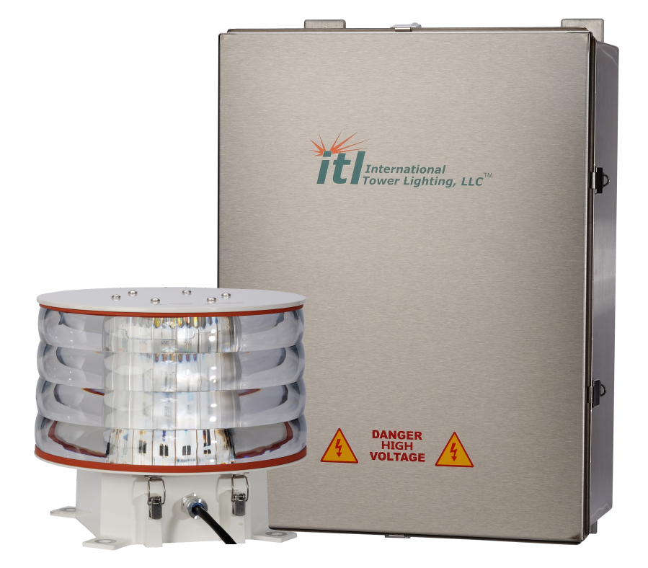
ILS-3600 Installation Training
Covers ILS-3600 and ILS-2600

Slide 2
IPS-3600-0IR Layout
System Layout
Power Supply 1
Power Supply 2
System Wiring Diagram
Fuses (Input Power/PEC/Side Light) and Interlock Switch
Timing and Trigger Board PCB1
Capacitor Board PCB4
Side Light Control Board PCB2
FET Driver Board PCB5
Configuration Settings Description
Flash Head / Side Light / PEC / Input Power Terminal Block TB1
MON-2682 Communication Board
Alarm Status / Contacts PCB3

Slide 3
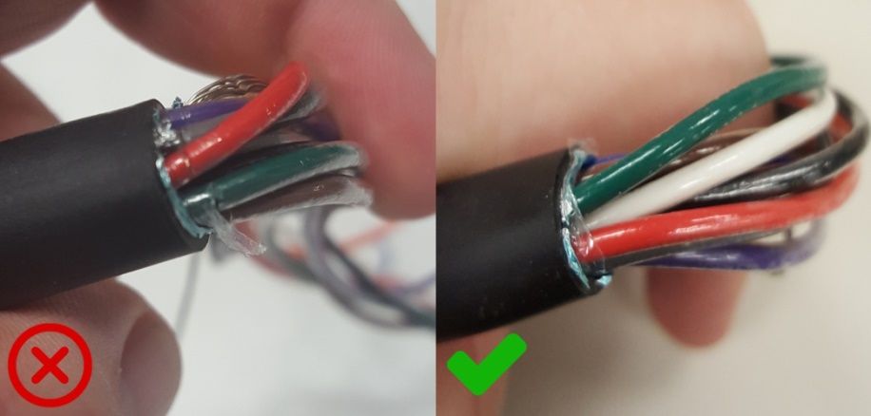
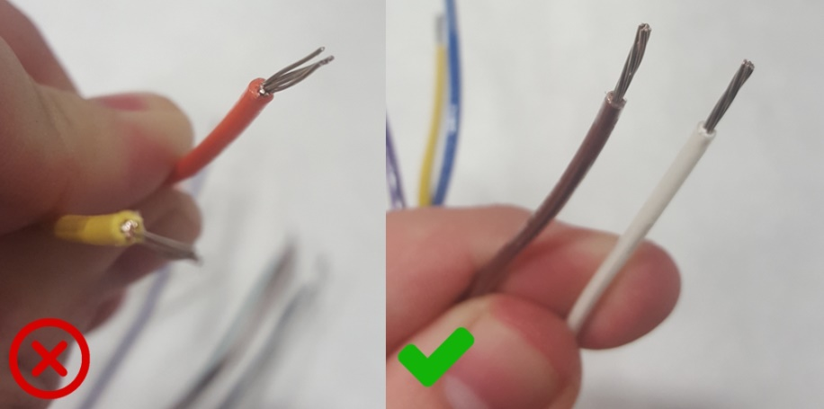
Cable Stripping / Termination
Individual conductor’s outer insulation not cut/damaged. (Usually where outer jacket was removed)
Conductors stripped without removing wire strands. (Use correct stripping tool for wire gauge)

Slide 4
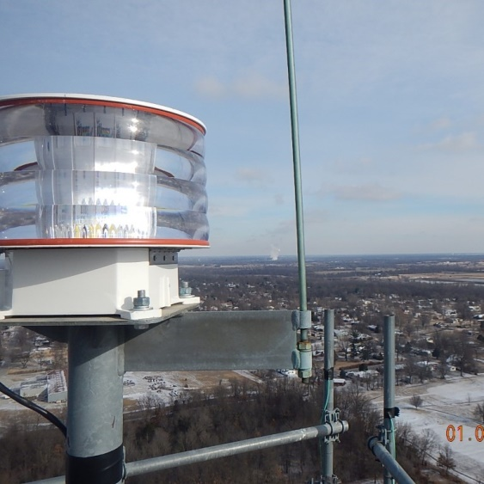
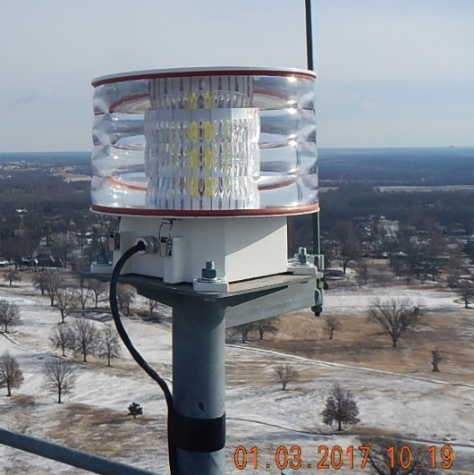
Flash Head / Flash Head Cable Install
Lightning rod installed no less than 18” away and 36” above flash head
Flash head mounted with bolts included without obstructions allowing 360° view
Cable gland secured around cable to prevent water intrusion
Drip loop created on cable exiting flash head
Cable secured to tower no more than 12” away from flash head with no stress on cable gland

Slide 5
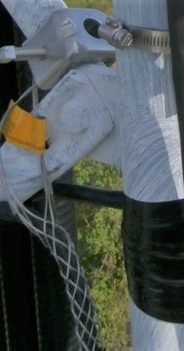
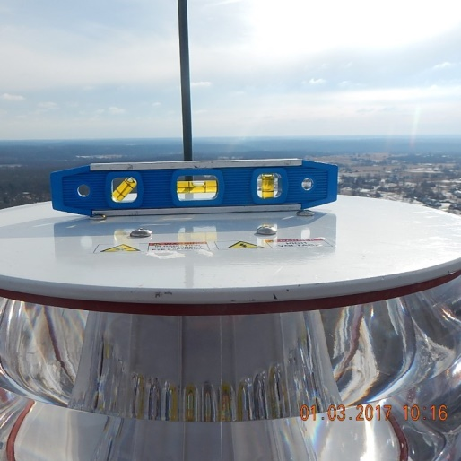
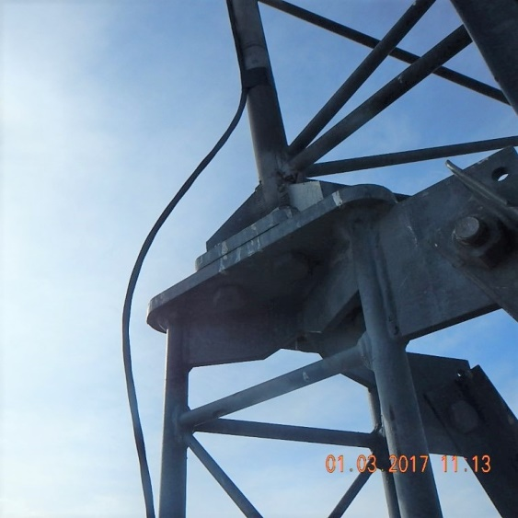
Flash Head / Flash Head Cable Install
Level the flash head both the North-South and East-West directions with user supplied level
Cable secured to the tower utilizing 2-3-4 method no more than every 5’
Cable secured 6” directly above and below and cross angles or tower leg flanges leaving 1” of space between cable and flange/angle
Cable mounted behind and not extending past any climbing pegs
Stainless steel cable support installed below service loop and secured to tower

Slide 6
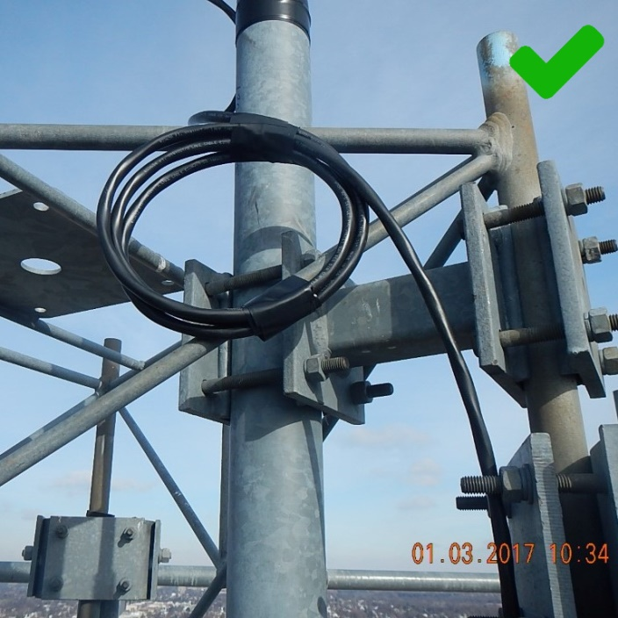
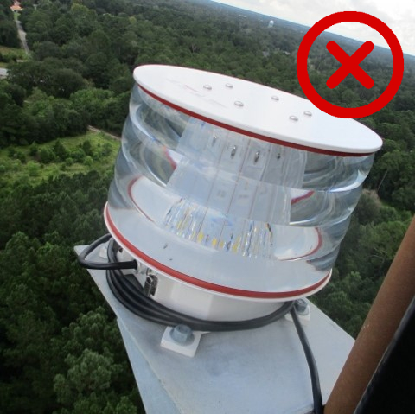
Flash Head / Flash Head Cable Install
24-48” service loop installed vertically to the tower below the flash head
Do not mount horizontally or around flash head base. This can allow water to accumulate

Slide 7
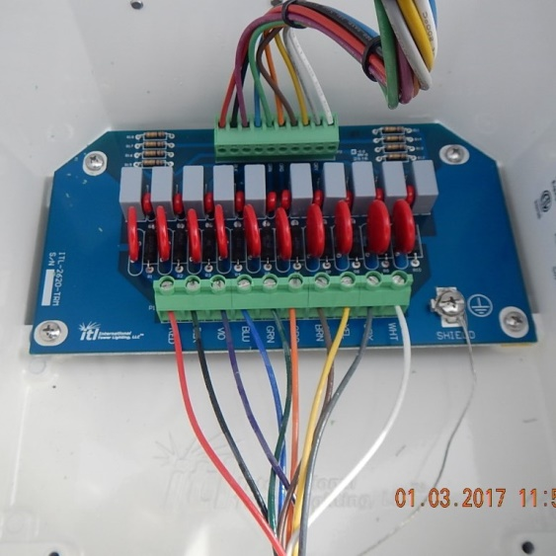
Flash Head / Flash Head Cable Install
Cable connections on terminal block wired to provided color code
Drain wire secured to ground lug and as short as possible

Slide 8
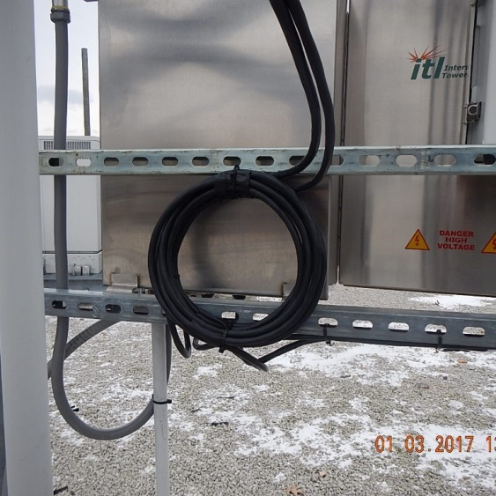
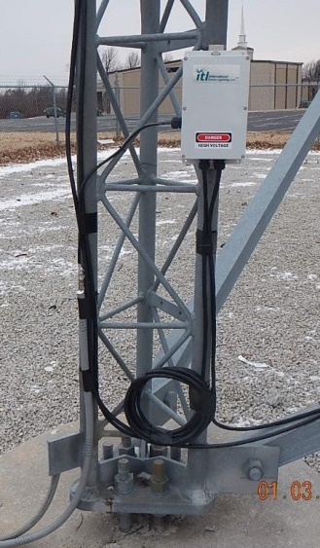
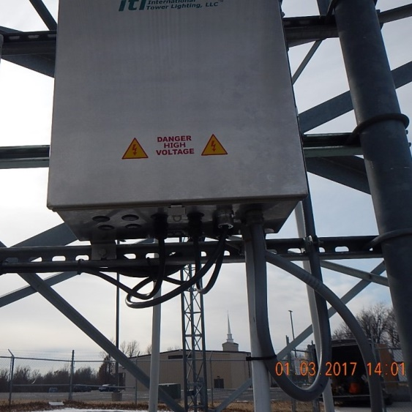
Flash Head / Flash Head Cable Install
24-48” service loop installed at base of tower near flash head surge suppressor
24-48” service loop installed at base of tower near power supply
Drip loops created before entering lighting controller

Slide 9
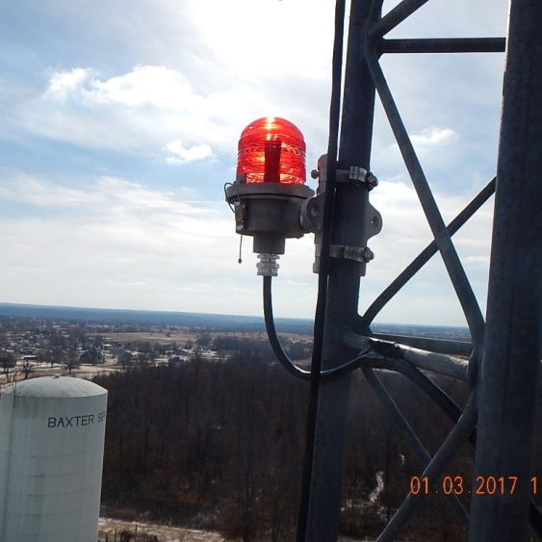
Side Light / Side Light Cable
Side Lights secured to tower using supplied mounts no more than 2’ from tower
All cable glands secured around cable to prevent water intrusion
Stainless steel cable support installed below service loop and secured to tower
Cable secured to the tower utilizing 2-3-4 method no more than every 5’

Slide 10
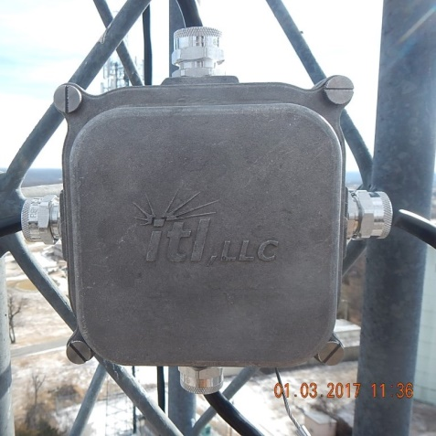
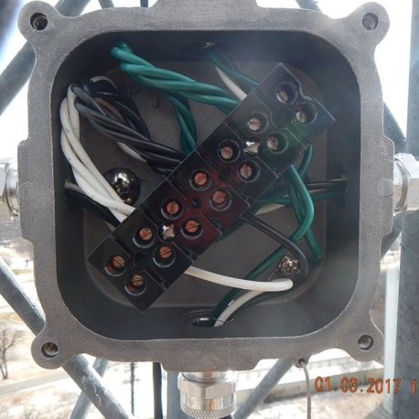
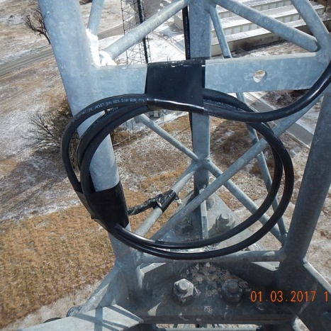
Side Light / Side Light Cable
Junction box mounted to tower securely in correct orientation and service loop mounted below junction box vertically
Cable secured 6” directly above and below and cross angles or tower leg flanges leaving 1” of space between cable and flange/angle

Slide 11
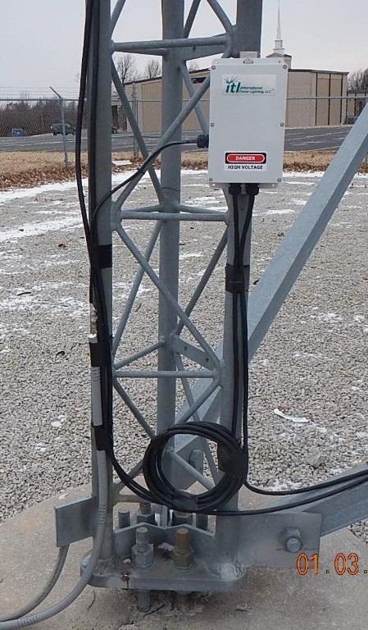
Flash Head Surge Suppressor
Mounted close to the tower ground buss bar
Supplied ground wire should be grounded to tower ground buss bar without extending
Cable glands secured to prevent water intrusion
Enclosure cover secured with provided gasket and six mounting screws

Slide 12
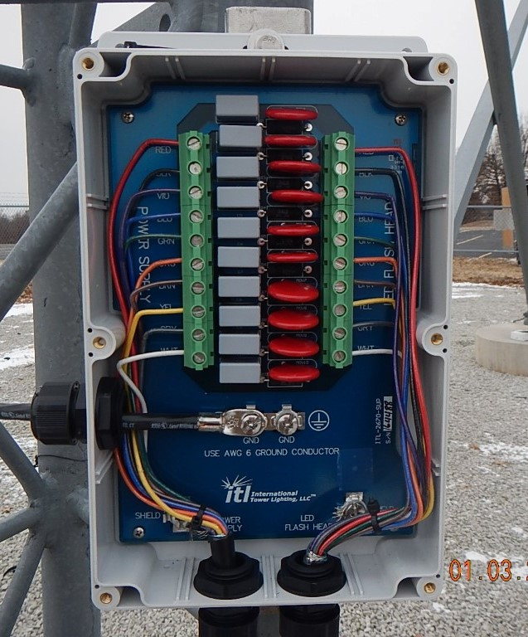
Flash Head Surge Suppressor
Flash head cable mounted to right terminal block following provided color code. Cable to lighting controller mounted to left terminal block following provided color code
Drain wires mounted to grounding lugs and as short as possible

Slide 13
Photo Electric Cell (PEC)
PEC mounted vertically with supplied materials
PEC facing north with no obstructions or light sources to affect proper operation

Slide 14
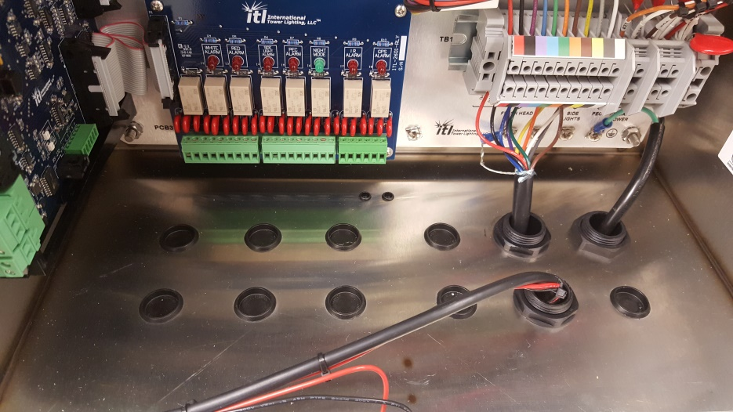
Power Supply
System mounted upright away from and direct RFI (Radio Frequency Interference)
No holes created in system other than the bottom of the enclosure
All unused holes sealed to prevent intrusion of debris/animals/insects
Door must open 180 degrees freely without obstruction

Slide 15
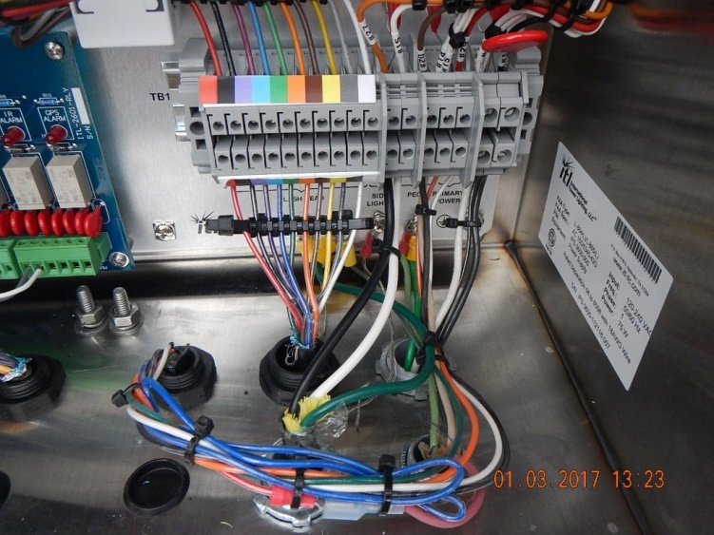
Power Supply
Flash head cable wires connected to TB1 positions 1-10 following color code on TB1
Side Light cable installed on TB1 positions 11 & 12 with ground connected to ground lug
Photo Electric Cell (PEC) cable installed on TB1 positions 13-15
Input power cable installed on TB1 positions 16 & 17 with ground connected to ground lug

Slide 16
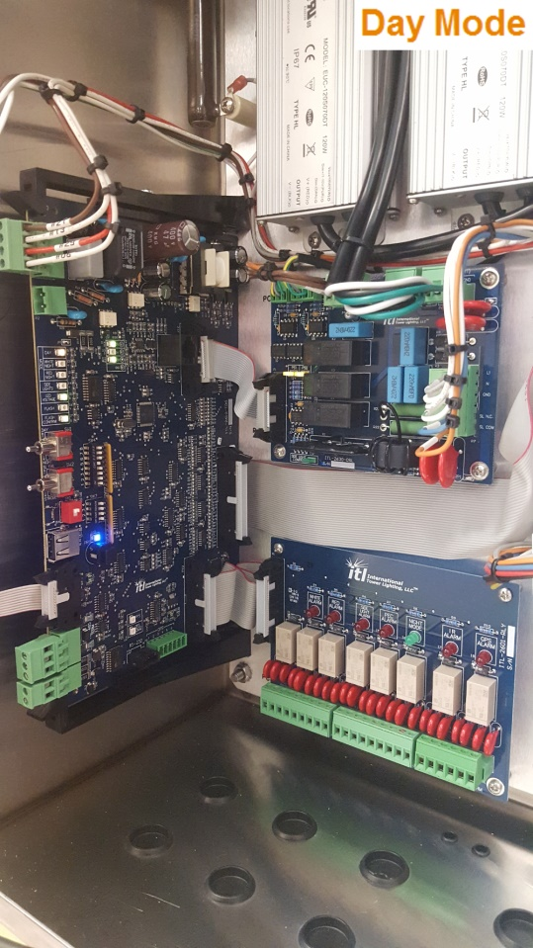
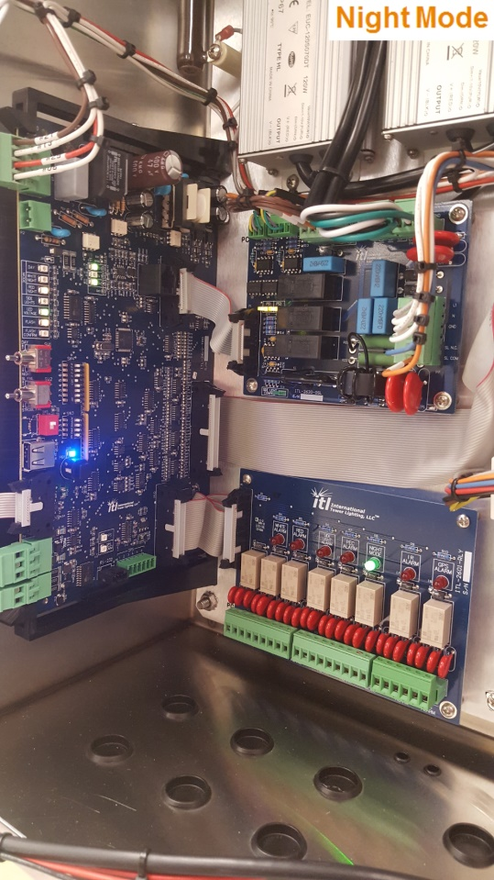
Testing
System operates in day mode for 10 consecutive minutes without any alarm LEDs on PCB3
With PEC covered system switches to night mode within one minute
With PEC covered and system in night mode verify operation with no alarm LEDs on PCB3 for at least 10 consecutive minutes

